Slide 1
SECURE DATA HIDING IN IMAGES USING STEGANOGRAPHY
CAPSTONE PROJECT
Presented By:
Student Name : Hanish Kandikattu
College Name & Department : SRM University, Ramapuram | Computer Science & Engineering (Cybersecurity)

Slide 2
OUTLINE
Problem Statement
Technology used
Wow factor
End users
Result
Conclusion
Git-hub Link
Future scope

Slide 3
PROBLEM STATEMENT
In today’s digital world, secure communication is crucial. Traditional encryption methods may attract attention, while steganography allows discreet message hiding. This project aims to hide and retrieve secret messages inside images using Python, ensuring secure information transfer without raising suspicion.

Slide 4
TECHNOLOGY USED
Programming Language: Python
Libraries: OpenCV, Tkinter, NumPy, PIL (Pillow)
Platform: Windows/Linux
GUI Framework: Tkinter

Slide 5
WOW FACTORS
✅ User-Friendly GUI – Simple interface with file selection and pop-up messages ✅ Password Protection – Only users with the correct passcode can decrypt messages ✅ Efficient Message Storage – Message length encoded in the image to avoid garbage output ✅ Cross-Platform Support – Works on both Windows and Linux ✅ Lightweight & Fast – No heavy dependencies, easy to install and run

Slide 6
END USERS
Cybersecurity Enthusiasts – Learning about steganography and secure communication
Developers – Integrating steganography into larger security applications
Journalists & Activists – Securely sharing sensitive information
Students & Researchers – Exploring hidden data techniques

Slide 7
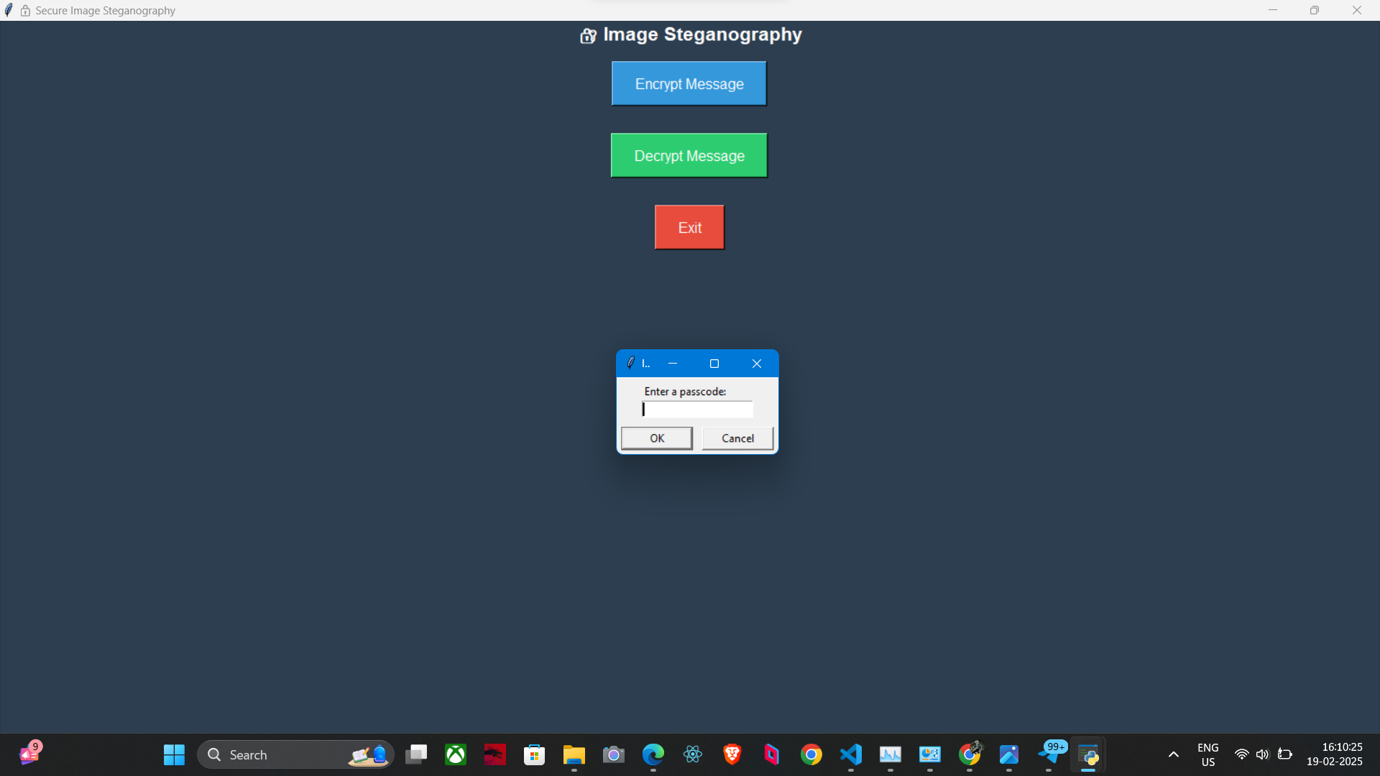
RESULTS
✅ Encryption: Secret message successfully hidden inside an image ✅ Decryption: Original message retrieved with correct password ✅ Screenshots of the GUI

Slide 8
CONCLUSION
This project successfully demonstrates secure message hiding using image steganography. The system provides password-protected encryption and decryption, ensuring safe communication. With an easy-to-use GUI, even non-technical users can securely hide and retrieve messages.

Slide 9
GITHUB LINK
https://github.com/hanish-77/SECURE-DATA-HIDING-IN-IMAGES-USING-STEGANOGRAPHY

Slide 10
FUTURE SCOPE(OPTIONAL)
Enhanced Security – Integrate AES encryption before embedding the message
Support for Multiple File Types – Extend functionality to videos and audio files
Improved Stealth – Make image modifications less detectable

Slide 11
THANK YOU

